Slide 1

RESEARCH

Slide 2
WHAT IS RESEARCH?
An activity of answering the question or solving the problem by using systematic procedure.
An activity that usually leads to discovery of new knowledge or new understanding related to topic involved.
An organized way of finding answer.

Slide 3
RESEARCH can be understood as
Structured inquiry
An effective use of method
Problem solving activity
Process of generating new knowledge

Slide 4
How much information I have about the issue ? (Pre-Review)
Problem/Question (Why it emerged?)
Finding the importance of problem/question (when solved)
Need of doing research (finding answer/solution)
Setting goal (what to achieve)
Stating objectives (how to achieve)
Stating hypothesis (if wants to see cause effect relationship)
Literature Reviews:
To find out what others have done so far
What type of research being selected?
How it is being done
To get more knowledge about the topic
To reconstruct problem and objectives
To find out what theoretical explanation being provided)
Conceptual framework
How to answer the Q?
What factors to include or how to measure the cause and effect?
What method to use?
What sample to collect, how?
What theory to use ?
How to link all above in a single thread?
Methods
What type of data are qualified to answer the question?
What method to select (quantitative or quantitative) ?
Whom to ask the question?
How much information (sample) is adequate ?
What type of information to collect (Qualitative or Quantitative or both) ?
How to collect the question (Tools)

Slide 5
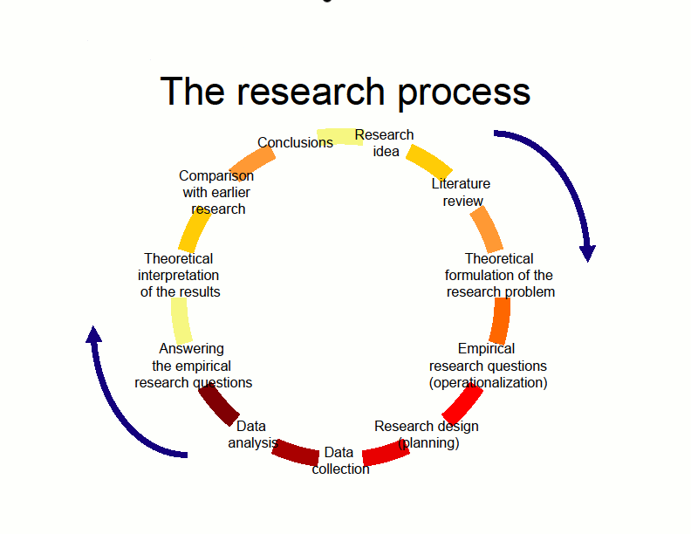

Slide 6
Empirical – evidence based
Controlled – No infection by other factors
Rigorous – relevant, appropriate
Systematic – logical sequence (1,2,3,4,…)
Valid & Verifiable – repeatable, testable
Critical – investigation process must be foolproof (methods).
Problem focuses
PREVaCCS

Slide 7
WHAT IS RESEARCH PROCESS?
Research process itself involves identifying, locating, assessing, analyzing, and then developing and expressing your ideas.
A step-by-step process of developing a research plan. As one progress, it is commonly necessary to backup, revise, add additional material or even change the topic completely.
Process of adjusting oneself according to research outcome.

Slide 8
STEPS IN RESEARCH

Slide 9
Steps in reaching to research goal
GOAL
6 Method
5 Conceptual frame
4 Review literature
3 Objectives
2 Research Q.
1 Problem
Literature Review

Slide 10
Preliminaries
Title, Recommendation, etc.
Chapter 1
1. Introduction
Problem
Hypothesis or
Objectives
2. Reviews of Literatures
Conceptual framework
Organization of the thesis
3. Methods of study
4. Result, Discussion, &
Conclusion
Appendix
Reference
Chapter 2
Chapter 3
Chapter 4
No Chapter

Slide 11
INTRODUCTION
AND
BACKGROUND

Slide 12
INTRODUCTION/BACKGROUND
Locate research topic in its context and background.
How and Why topic as a research problem arise?
Why it is worth doing?
What will be the outcomes and how significant the research is and for whom?

Slide 13
SEVERAL WAYS TO PROVIDE BACKGROUND
Theoretical interest to explain the particular phenomenon
To test the particular theory and its explanation (caste theory and four castes)
To unearth the fact, unexplored issue (e.g., marital rape in Nepal)
The analysis should lead you to interrogate your own assumptions about why the problem is significant.

Slide 14
WHAT TO REMEMBER MOST….
The main purpose of the introduction is to provide the necessary background or context for your research problem.
Poorly framed research problem lead to uninteresting research question. It should be placed in context and focused on current research area. Review of current literature is necessary

Slide 15
The introduction generally covers the following elements:
State research problem (purpose of the study).
Context that explains why it is necessity and importance.
Provide rationale to indicate why it is worth doing.
Briefly describe the major issues and sub-problems to be addressed by your research.
Identify the key variables (e.g., suicide research)
State hypothesis. For exploratory research no hypothesis (e.g., Mother & child health practices of Rajbansi)
Provide a clear focus.
Provide definitions of key concepts. (This is optional.)

Slide 16
The research problem

Slide 17
The research problem
First and most important step
It identifies the research DESTINATION, DIRECTION and tells WHAT and HOW you intend to do.

Slide 18
The research problem
“A problem is like a foundation of a building - the better it is designed the stronger the building will be.”
“Like a guidepost it tells how and where to move.”

Slide 19
THE RESEARCH PROBLEM
It tells why the research is significant and ‘worth doing’.
If not well stated, the quality of result suffers.

Slide 20
A PROBLEM EMERGES WHEN…
When there is gap in knowledge (e.g., does mentally sick abuse drug or drug abuser becomes mentally sick? Or both?
When the result conflicts or contradict (e.g., alcohol and domestic violence)
When there is no literatures (e.g., ‘The Newars’ by Prof. Dr. Gopal Singh Nepali)

Slide 21
What is the good criteria of stating research problem?
The Simple the best (To test the level of intelligence of ….)
Understandable and complete (Socialization practices on Nepalese people)
Clear-cut/not ambiguous (e.g., does smoking cause cancer? or ‘Good’ performance)
Solvable (e.g., are all men mortal?)
Variables included (e.g., see no. 3)

Slide 22
WHAT IS HYPOTHESIS?

Slide 23
A guess …tentative answer.
A predictive statement
Testable
Composed of Variables
Clarity (functional definition) in variables is must
e.g., IV, DV, RV….etc.
Smoking causes cancer
Independet variable
Dependent variable

Slide 24
OBJECTIVES OF THE STUDY

Slide 25
What is research objective?
Objectives are goals set to achieve
Tells readers what and how researcher attempting to achieve by research
What critical factors are included
The clear the objectives the clear the goal
In descriptive and explanatory studies objectives are important to state.

Slide 26
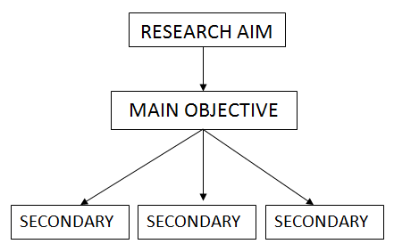
How Objectives are stated?
There are main objective and sub-objectives.
Main objective is an overall statement of the thrust of the study while specific objectives are the specific aspects of the topic that the researcher wants to investigate within the main framework of the study.

Slide 27
Points to remember
Objective helps to identify
THE KEY STUDY VARIABLES (FACTORS)
THEIR POSSIBLE INTERRELATIONSHIPS.
IT IS IMPORTANT TO REVIEW THE LITERATURE TO PRECISELY IDENTIFY THE CRITICAL FACTORS OR VARIABLES RELATED TO THE STUDY.

Slide 28
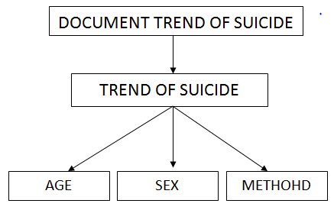
Who commits more suicide in terms of age?
Who commits more suicide in terms of sex?
What major methods are used to commit suicide?
WHO IS THE VULNERABLE GROUP?

Slide 29
OPERATIONAL DEFINITION
OF
KEY TERMS

Slide 30
Operational definitions of the key terms
Define key variable (key term) e.g., ‘violence’ or ‘cancer’ is not clear term.
Definition provides operational meaning to the variable to describe and explain (e.g., sexual/domestic/marital/partner violence, etc).
Such definitions may differ from the dictionary definitions as well as from day-to-day meanings.
Example: Intelligence is what the test tests.

Slide 31
REVIEW OF LITERATURE

Slide 32
Reading books, articles, unpublished reports and theses.
Intensive and critical readings
To gain knowledge and ideas on topic
To frame the problem, justify the importance of research
It should be selective and critical.

Slide 33
Many literature reviews suffer from :
Lacking organization and structure
Lacking focus, unity and coherence
Being repetitive, Failing to cite influential papers
Failing to keep up with recent developments
Failing to critically evaluate cited papers
Citing irrelevant or trivial references
Depending too much on secondary sources (e.g., third author)

Slide 34
Conceptual Framework
FRAMEWORK : Main things, key factors, presumed relationship, and theoretical notion
It can be…..Rudimentary, Elaborate, Theory‐driven, Descriptive or Causal

Slide 35
Conceptual Framework
SUGGESTIONS
Best done in graphic rather than in text.
Expect to do several instructions.
In group research work comparing the several version of framework is good.
Avoid the no‐risk framework (having two directional arrows everywhere).

Slide 36
Conceptual Design
1. Write down 3-7 key concepts from your research object (more underlying concepts can be added during the steps below, if necessary). These can be entity like (e.g. negotiation support system) or phenomenal (e.g. search efficiency).

Slide 37
WHAT IS RESEARCH DESIGN?

Slide 38
A blue print, road map about methodology
A detailed plan for how a research study is to be completed
It contains variables so they can be measured, type and size of sample of interested in
Date type and collection process
Analysis appproach
(Thyer, 1993)

Slide 39
A research design is a procedural plan that is adopted by the researcher to answer questions validly, objectively, accurately, and economically.
It is an arrangement of conditions to collect the data

Slide 40
Conceptual Model
Beliefs
(Cultural Variable)
Traditional
Dichotomy Corollary
Choice Corollary
Non traditional
Personal Construct
Narrow-Minded
(Rigid)
or
Broad-Minded
(Flexible)
Hindu
Rigid Vs Liberal
Narrow range (Rigid)
Not to Accept
Religious Practices
(Social Variable)
farm techno-
logy
Non-Hindu Rigid Vs Liberal
Accept
Broad Range (Liberal)
Community
(Ecological Variable)
Mountain
Hill
Tarai
Macro Level Process Analysis
Micro Level Process Analysis

Slide 41
METHODS

Slide 42
METHODOLOGY
Methodology, put simply, is the research methods one is intend to develop or employ and their justification.
It is more than a description of the techniques or procedures proposed, and should outline the key assumptions the researcher's approach makes.
Methodology to be adopted in conducting the research should be consistent to the objective, scope and conceptual framework of the study.

Slide 43
METHODOLOGY
Describes the design of the proposed study.
Describes your population and sampling procedure.
Describes the measuring instrument to be used.
Describes the procedure and the time frame of data collection.
Describes how you will analyze the data.

Slide 44
Example…
OBJECTIVES | Sample area | METHODS (Qualitative or Quantitative) | TYPES OF SAME.E | SAMPLE, SIZE | TOOLS
OBJECTIVE 1 |  | QUALITATIVE? | WOMEN/CHILD LITERATE ILLITERATE PATIENTS DOCTORS ETC | 50 | FGD OBSERVATION
OBJECTIVE 2 |  | QUANTITATIVE? |  | 100 | QUESTIONNAIRE
OBJECTIVE 3 |  | TRIANGULATION? |  | 500 | Interview

Slide 45

METHOD TYPES
Quantitative & Qualitative

Slide 46
Quantitative Method
Involves information or data in the form of numbers
Allows us to measure or to quantify things
Respondents don’t necessarily give numbers as answers - answers are analysed as numbers
Good example of quantitative research is the survey

Slide 47
Qualitative Method
Qualitative researchers seek answers to their questions in the real world. They gather what they see, hear and read from people and places and from events and activities … their purpose is to learn about some aspects of the social world and to generate new understandings that can be used by that social world
(Rossman and Rallis 1998:5).

Slide 48
Qualitative Method
Helps us flesh out the story and develop a deeper understanding of a topic
Often contrasted to quantitative research
Together they give us the ‘bigger picture’
Good examples of qualitative research are face-to-face interviews, focus groups and site visits

Slide 49
SOURCES OF INFORMATION

Slide 50
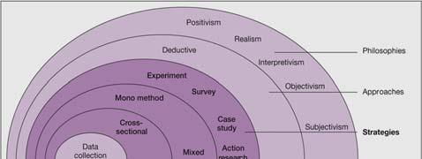
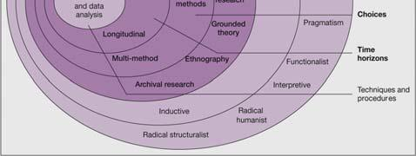
1
2
3
5
4
6

Slide 51
Data source
Ethicial issue

Slide 52
Data source
Primary: Primary data are those which are fresh and collected for the first time and thus happen to be original in character.
Secondary: Secondary data are those which have already been collected by someone else. Documents of past records, diary, literatures, autobiographies can be source of secondary data.

Slide 53
Ethical issue for the research
Each and every profession is guided by the code of ethics. There is also ethics for conducting research.
Research can be done on sensitive topics, information are collected from different groups of population, subjects are deceived and made to participate in (lab, natural, quasi experimental conditions) research, and researcher can be biased against certain group of people or withhold information, deprive treatment, or report incorrect information.

Slide 54
Ethical Rules
Respect for persons (autonomy)
Non-maleficence (do not harm)
Beneficence (do good)
Justice (exclusion if person does not want to participate)

Slide 55
Ethical considerations
Scientific validity - is the research scientifically sound and valid?
Recruitment - how and by whom are participants recruited?
Participation - what does participation in the study involve?
Harms and benefits - what are real potential harms and benefits of participating in the study?
Informed consent - have the participants appropriately been asked for their informed consent?

Slide 56
DATA SOURCE
Primary: Primary data are
those which are fresh and
collected for the first time
and thus happen to be
original in character.
PRIMARY SOURCE
Secondary data are those
which have already been
collected by someone
else. Documents of past
records, diary, literatures,
autobiographies can be
source of secondary data.
SECONDARY SOURCE

Slide 57
WHAT ARE THE
DIFFERENT
TYPES OF METHOD?

Slide 58
Surveys
Think clearly about questions (need to constrain answers as much as possible)
Make sure results will answer your research question
Can use Internet for conducting surveys if need to cover wide geographic reach

Slide 59
Face-to-face interviews
Must prepare questions
Good idea to record your interviews
Interviews take up time, so plan for an hour or less (roughly 10 questions)
Stick to your questions, but be flexible if relevant or interesting issues arise during the interview

Slide 60
Focus Group Discussion
Take time to arrange, so prepare in advance (use an intermediary to help you if you can)
Who will be in your focus group? (e.g. age, gender)
Size of focus group (8-10 is typical)
Consider whether or not to have separate focus groups for different ages or genders (e.g. discussing sex and sexuality)

Slide 61
Site visits and observation
Site visits involve visiting an organization, community project etc
Consider using a guide
Observation is when you visit a location and observe what is going on, drawing your own conclusions
Both facilitate making your research more relevant and concrete

Slide 62
Case studies
Method of capturing and presenting concrete details of real or fictional situations in a structured way
Good for comparative analysis

Slide 63
Participatory research
Allows participation of community being researched in research process (e.g. developing research question; choosing methodology; analysing results)
Good way to ensure research does not simply reinforce prejudices and presumptions of researcher
Good for raising awareness in community and developing appropriate action plans

Slide 64

Analysis of data
Data has to be processed and analyzed. Technically speaking, processing implies editing, coding, classification and tabulation of collected data so that they are amenable to analysis.

Slide 65
Results and Discussion
Result should be clearly indicated in writing or in tables
Result should clearly indicate the problem/hypothesis and objectives
Based on the theoretical model, the result should be discussed
The findings should be clearly stated.

Slide 66
THANK YOU

